Slide 1
2018 Montana Council Camporee
June 14-17th, 2018
Townsend, MT

Slide 2
What is Council Camporee?
Council Camporee is 4 days spent with over 1,000 Scouts and Scouters from across the state of Montana
Events and activities available for all participants
Shows featuring special guests, live band, fireworks, Scout Pep Band, skits, and more
Patches and Council Trading Post
Training opportunities

Slide 3
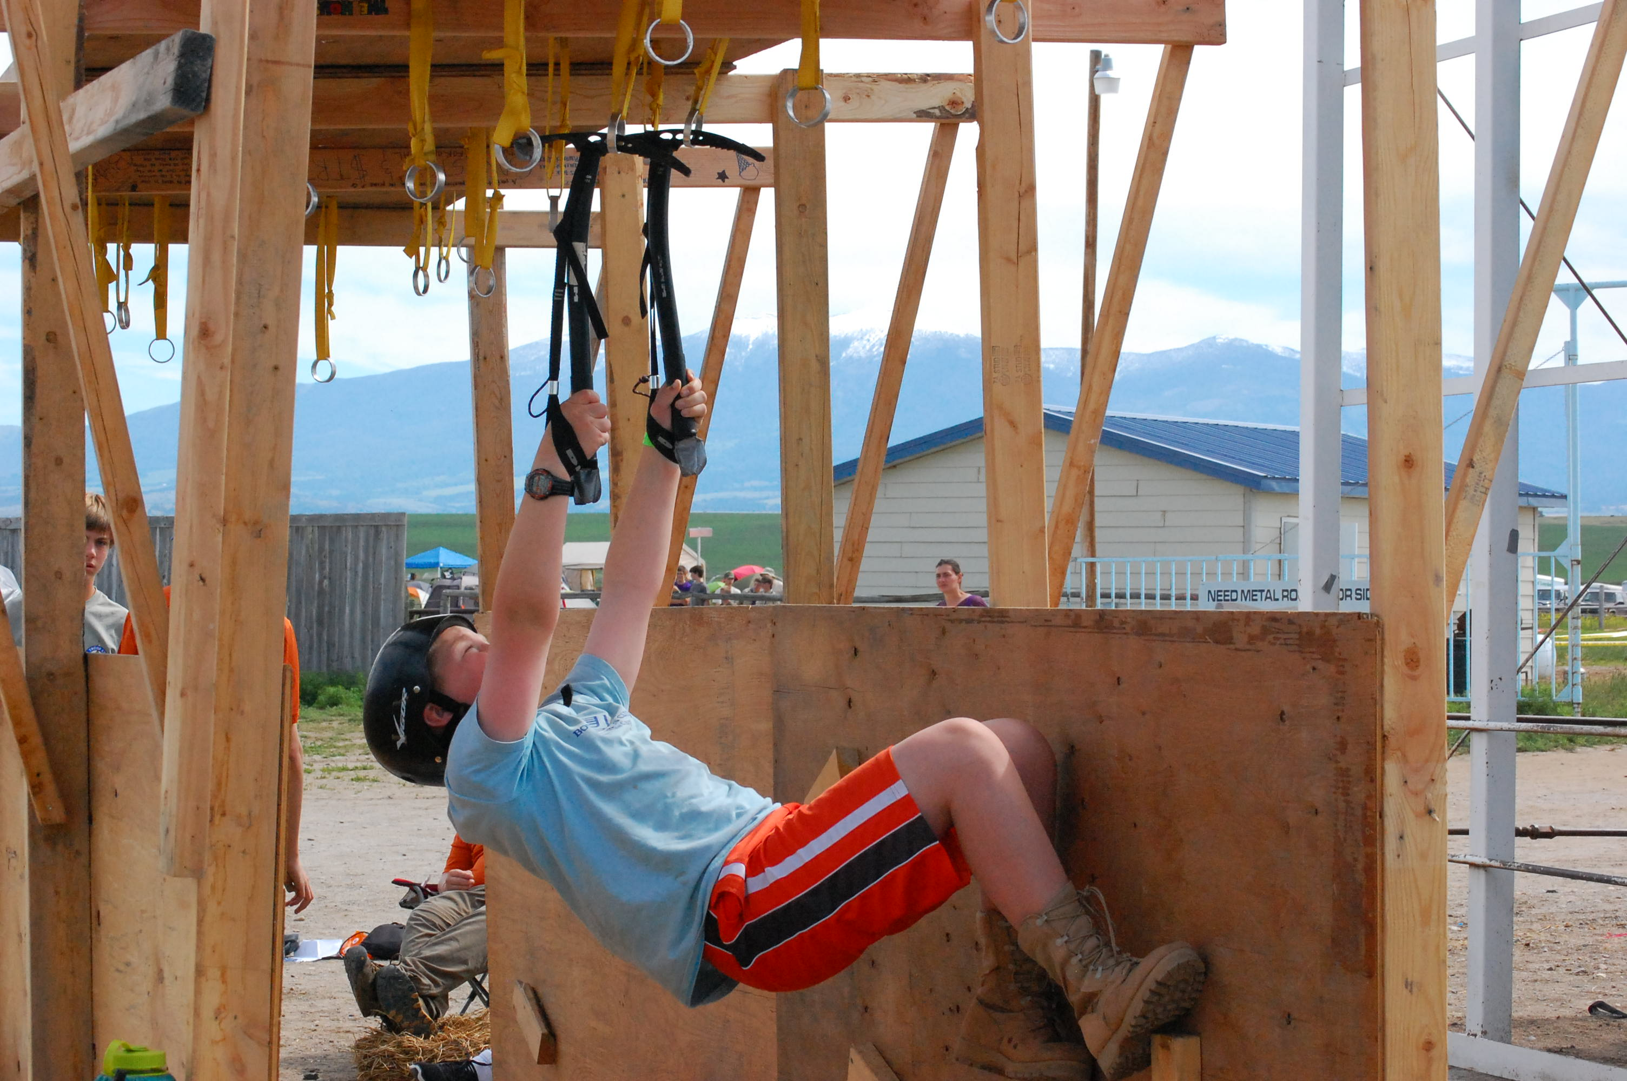
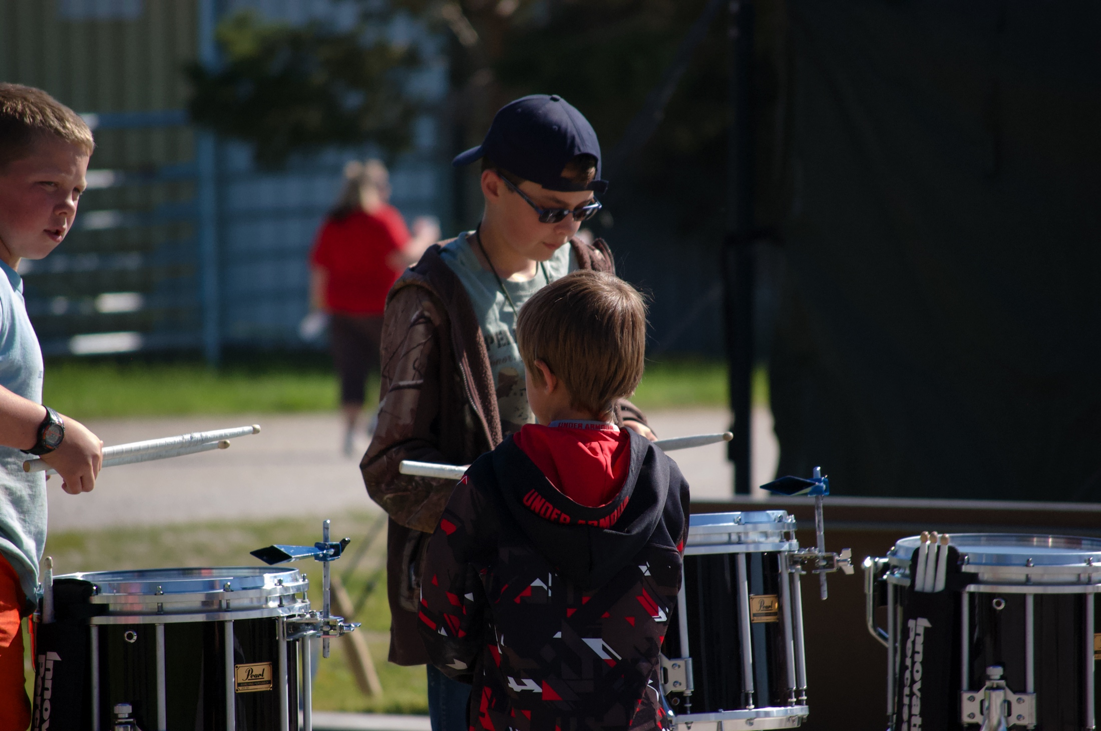
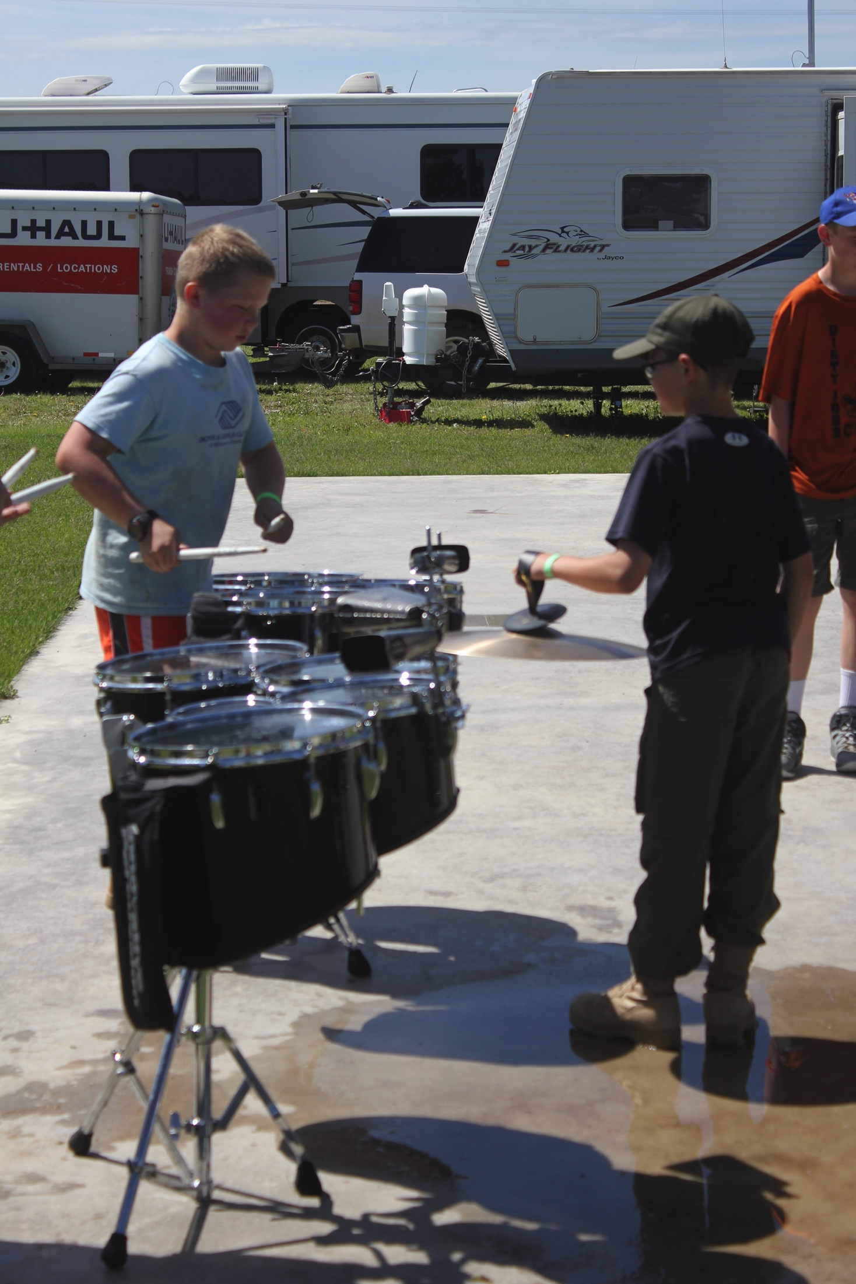
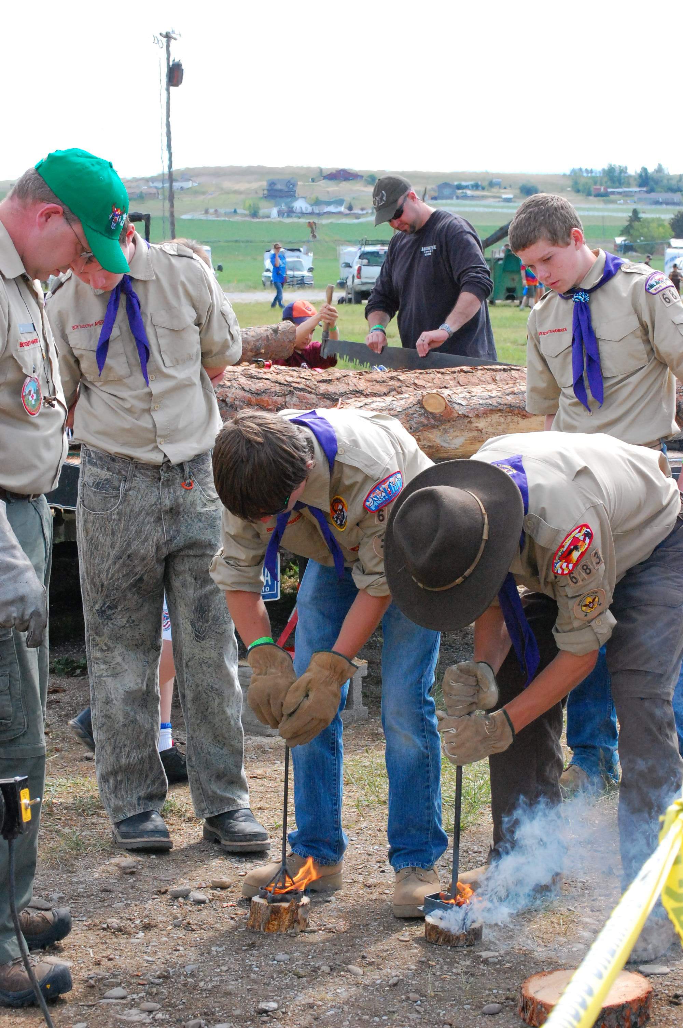
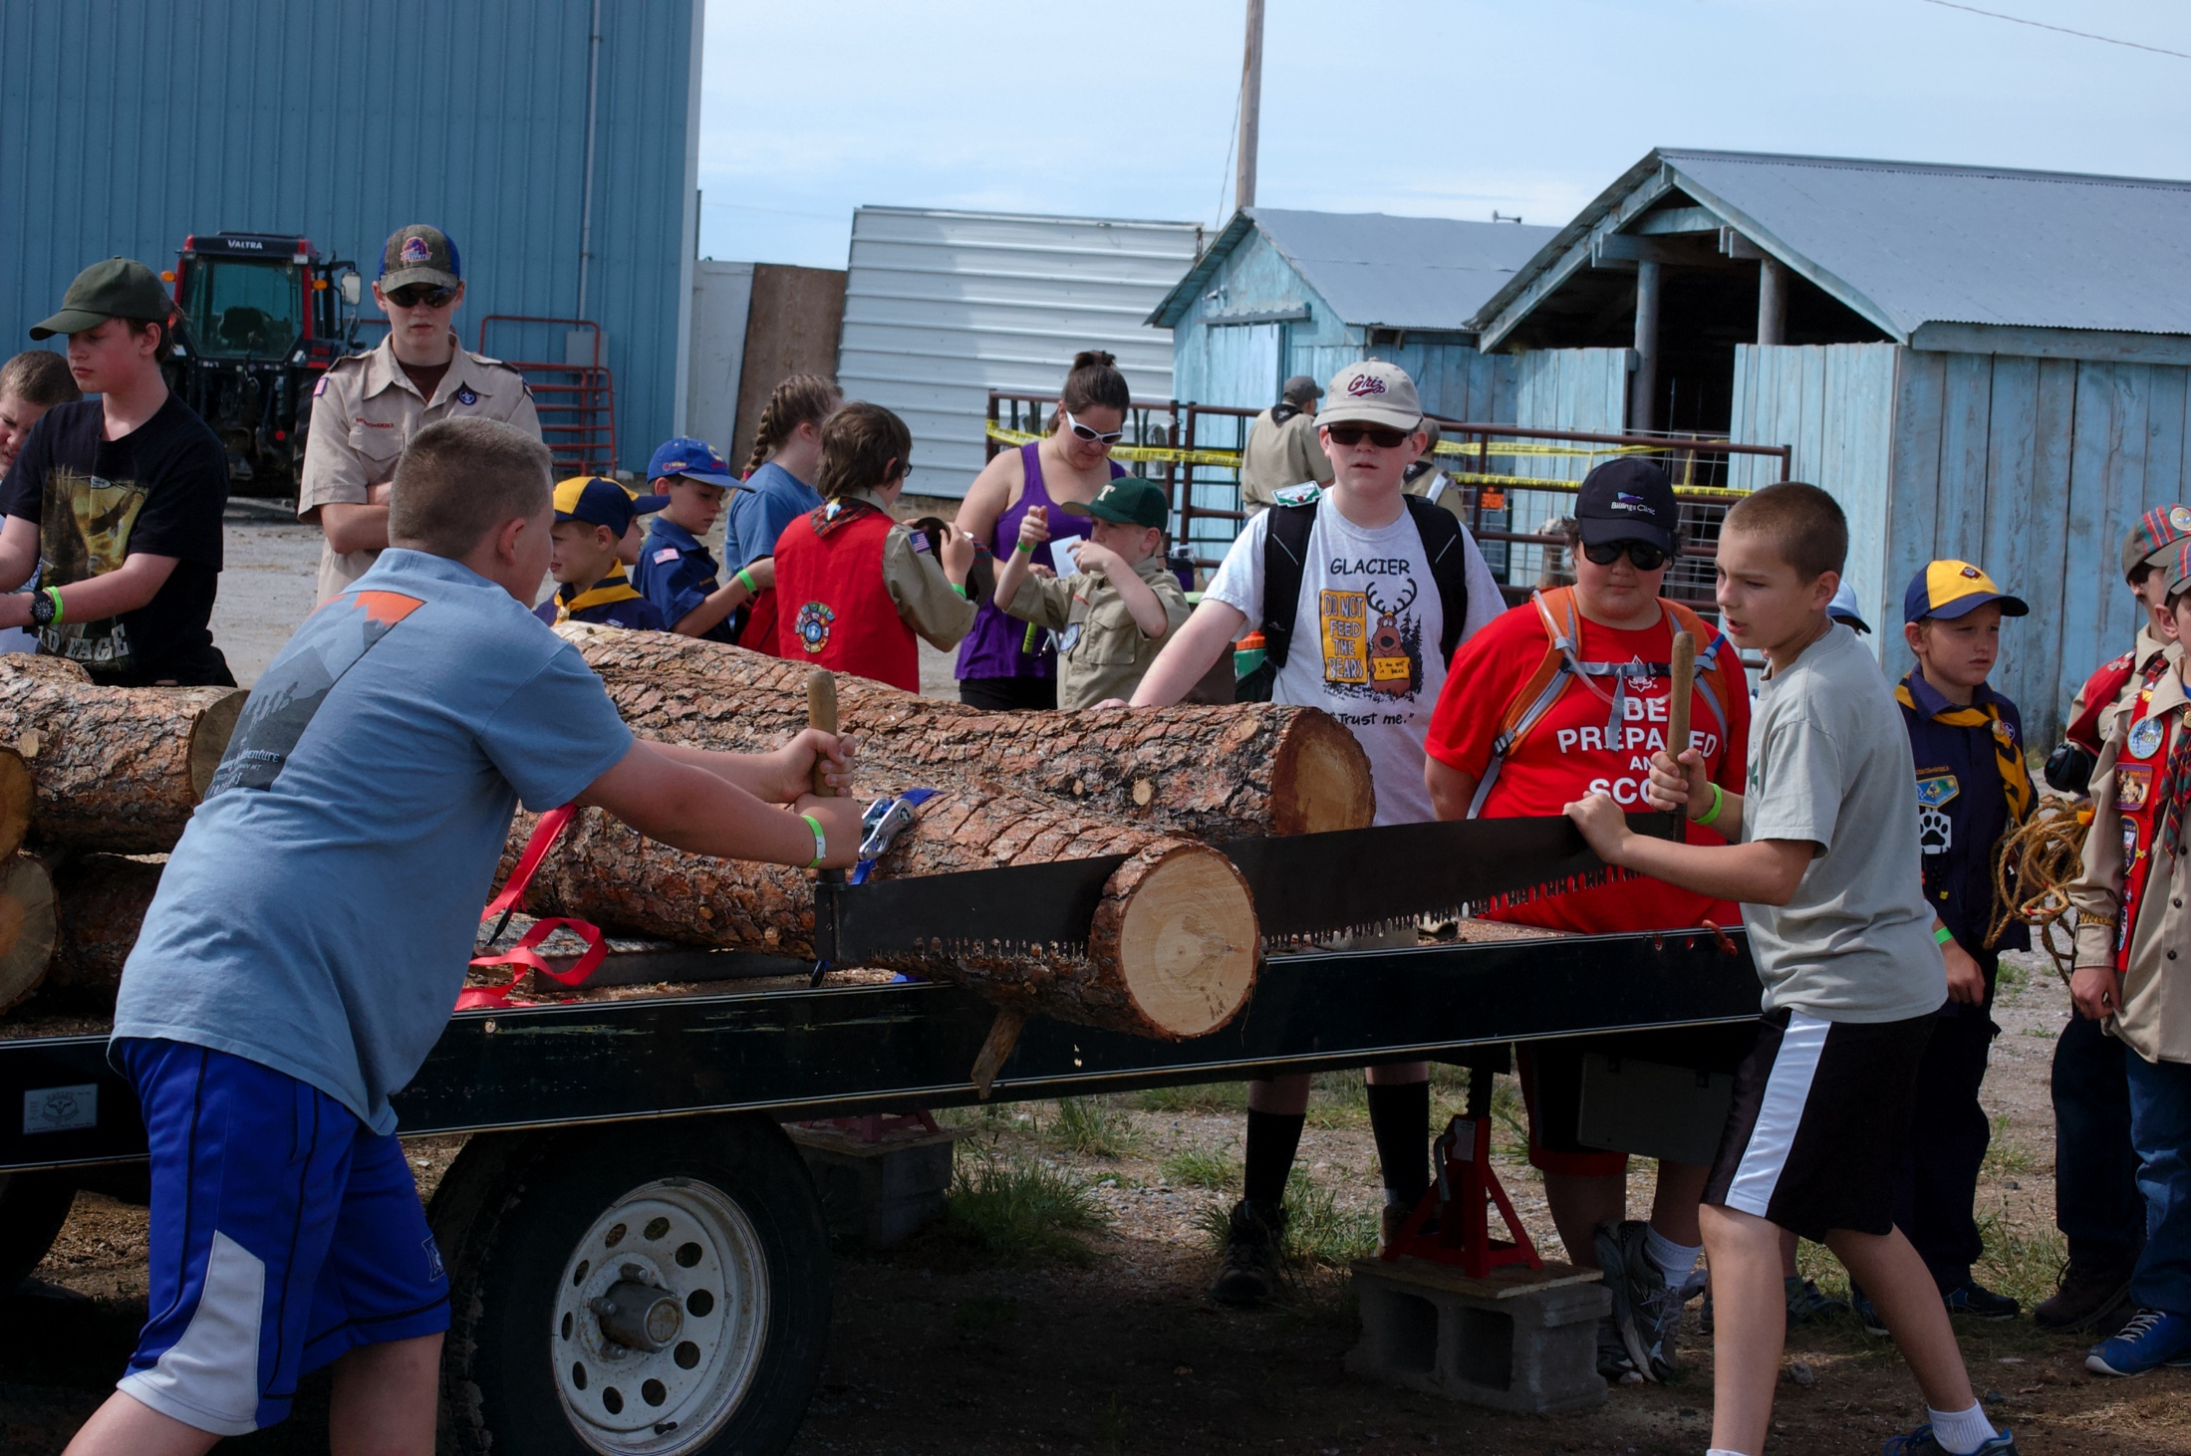
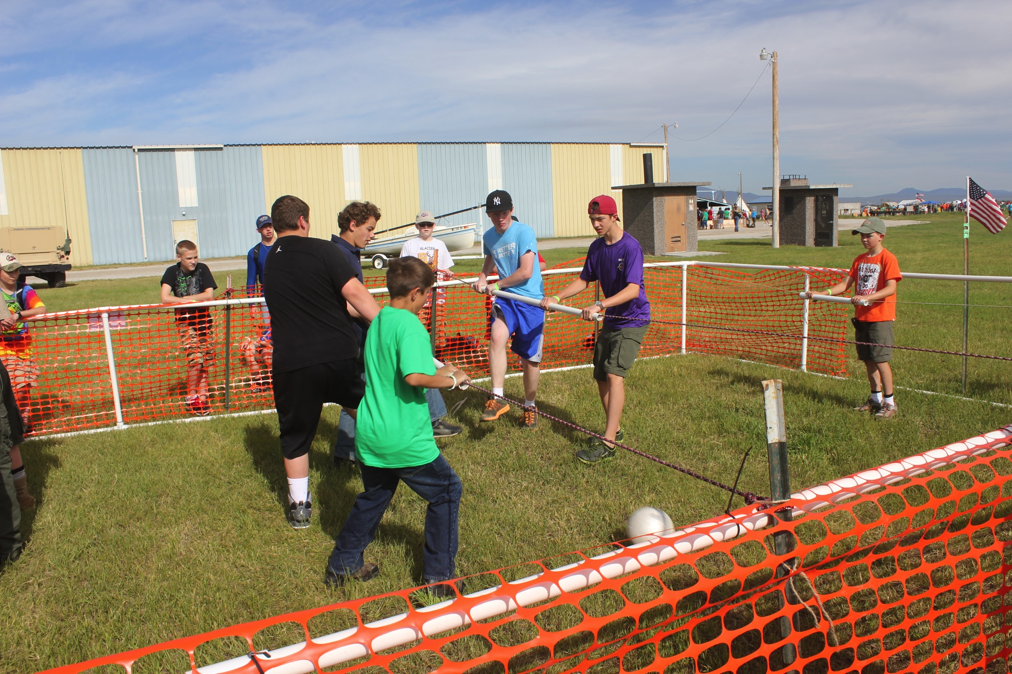

Slide 4
What Kind of Events?
Shooting Sports: Shotguns, BB Guns, and Archery
Scout Craft: Rope making, monkey bridge, water transfer, and more
Sports: Ga-Ga Ball, Ultimate Frisbee, Soccer, Fun Run
Other Events: Camp Games, Astronomy, Science Demos, Instrument Petting Zoo, Climbing Wall, Ice Cave, Obstacle Course, Life-size Foosball, and many more
Limited Opportunities: Plane Flights with Young Eagles, ATV Simulator/Training, Mini River Trek

Slide 5
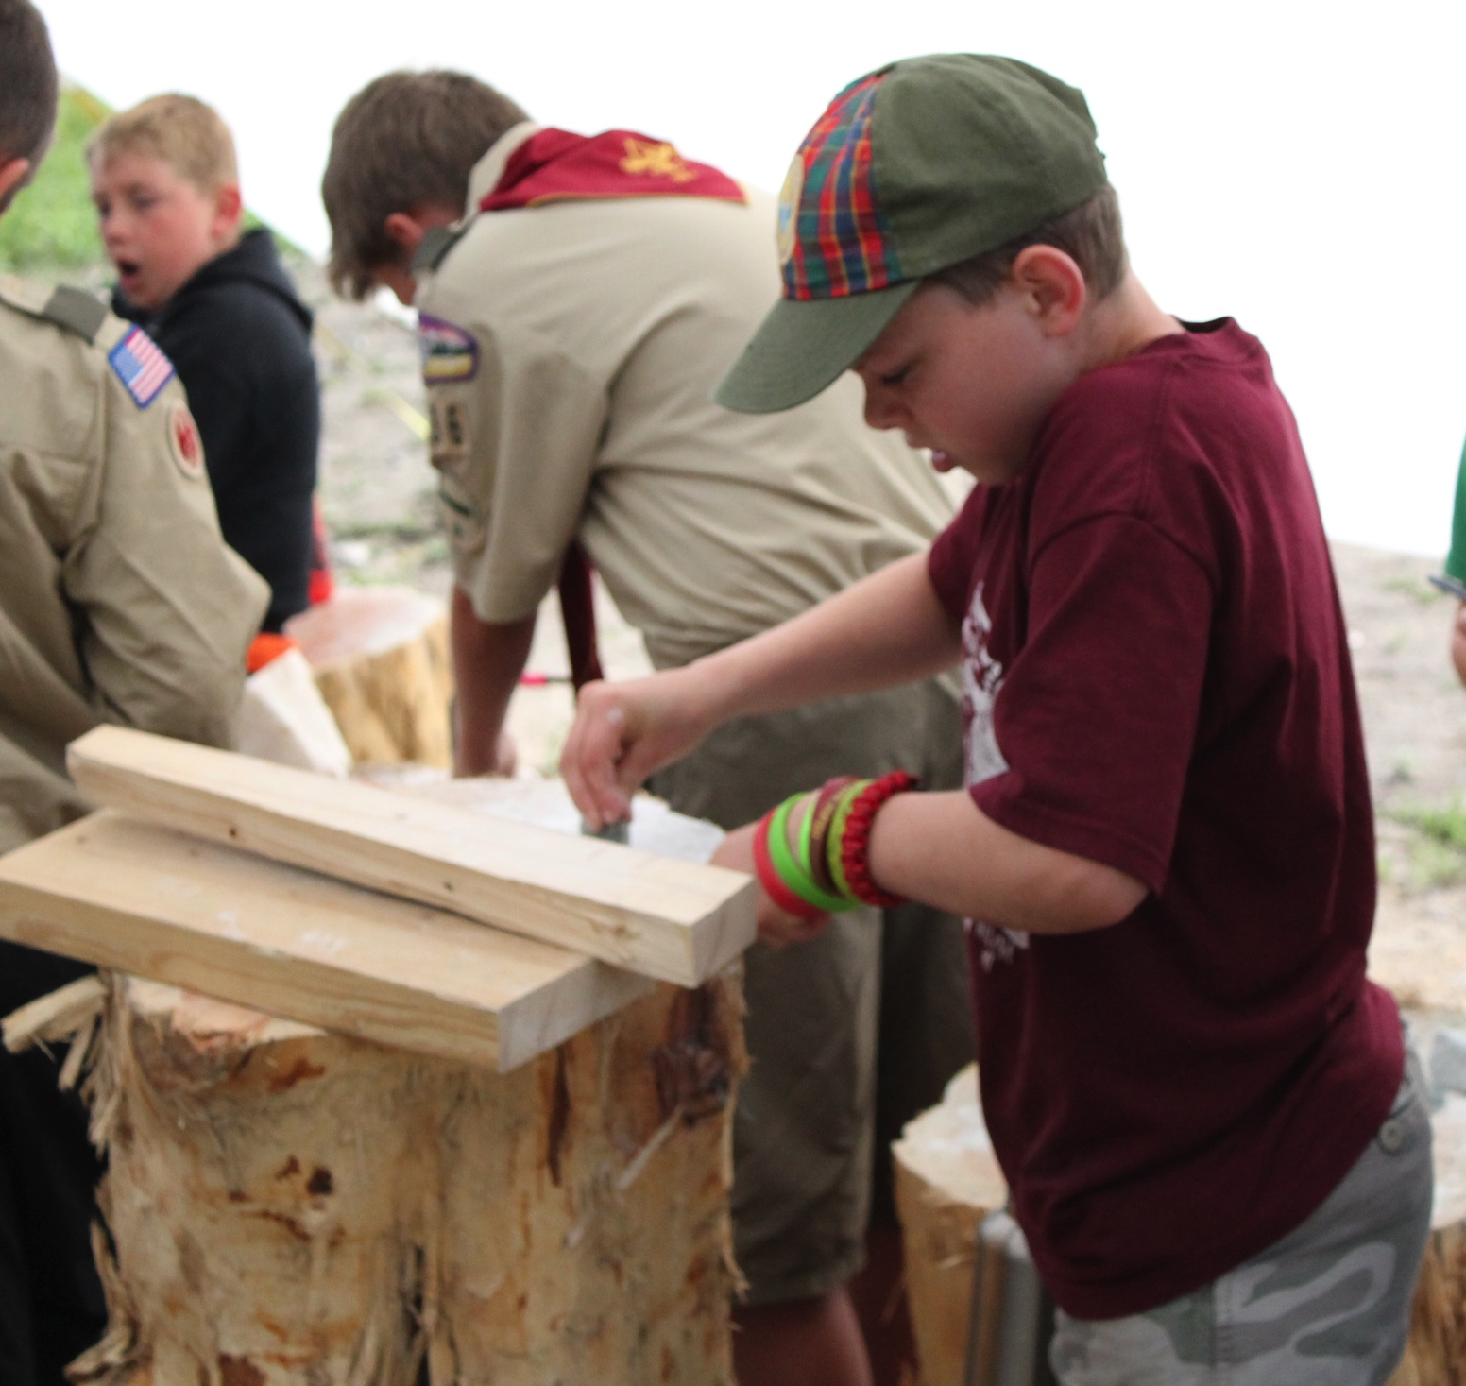
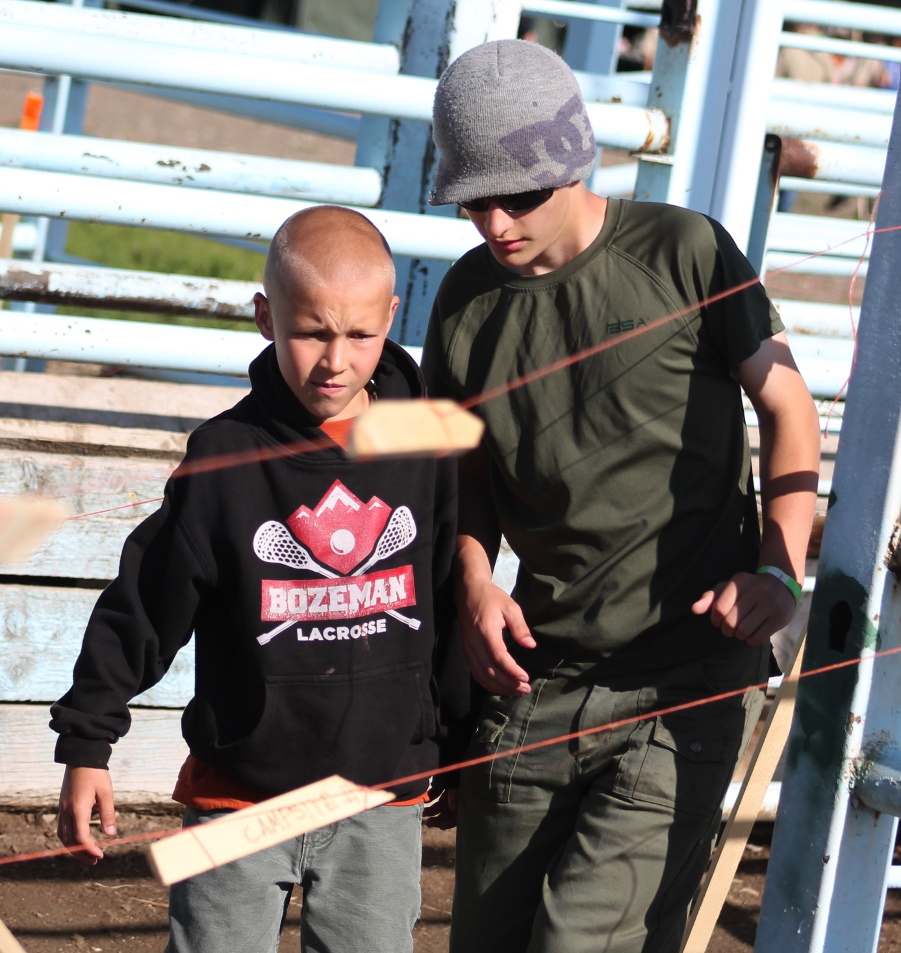
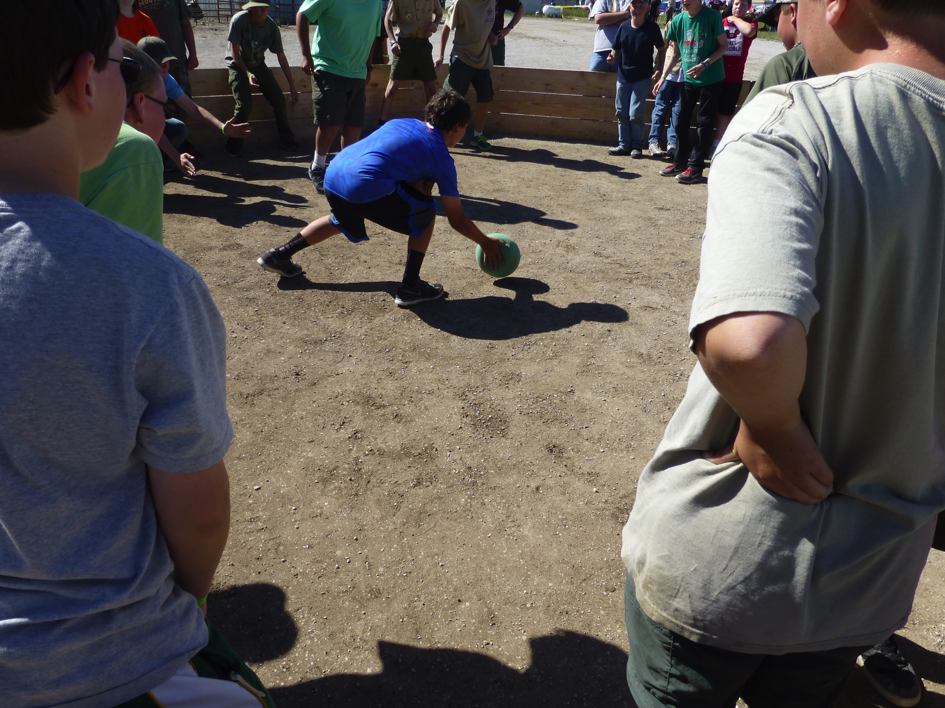
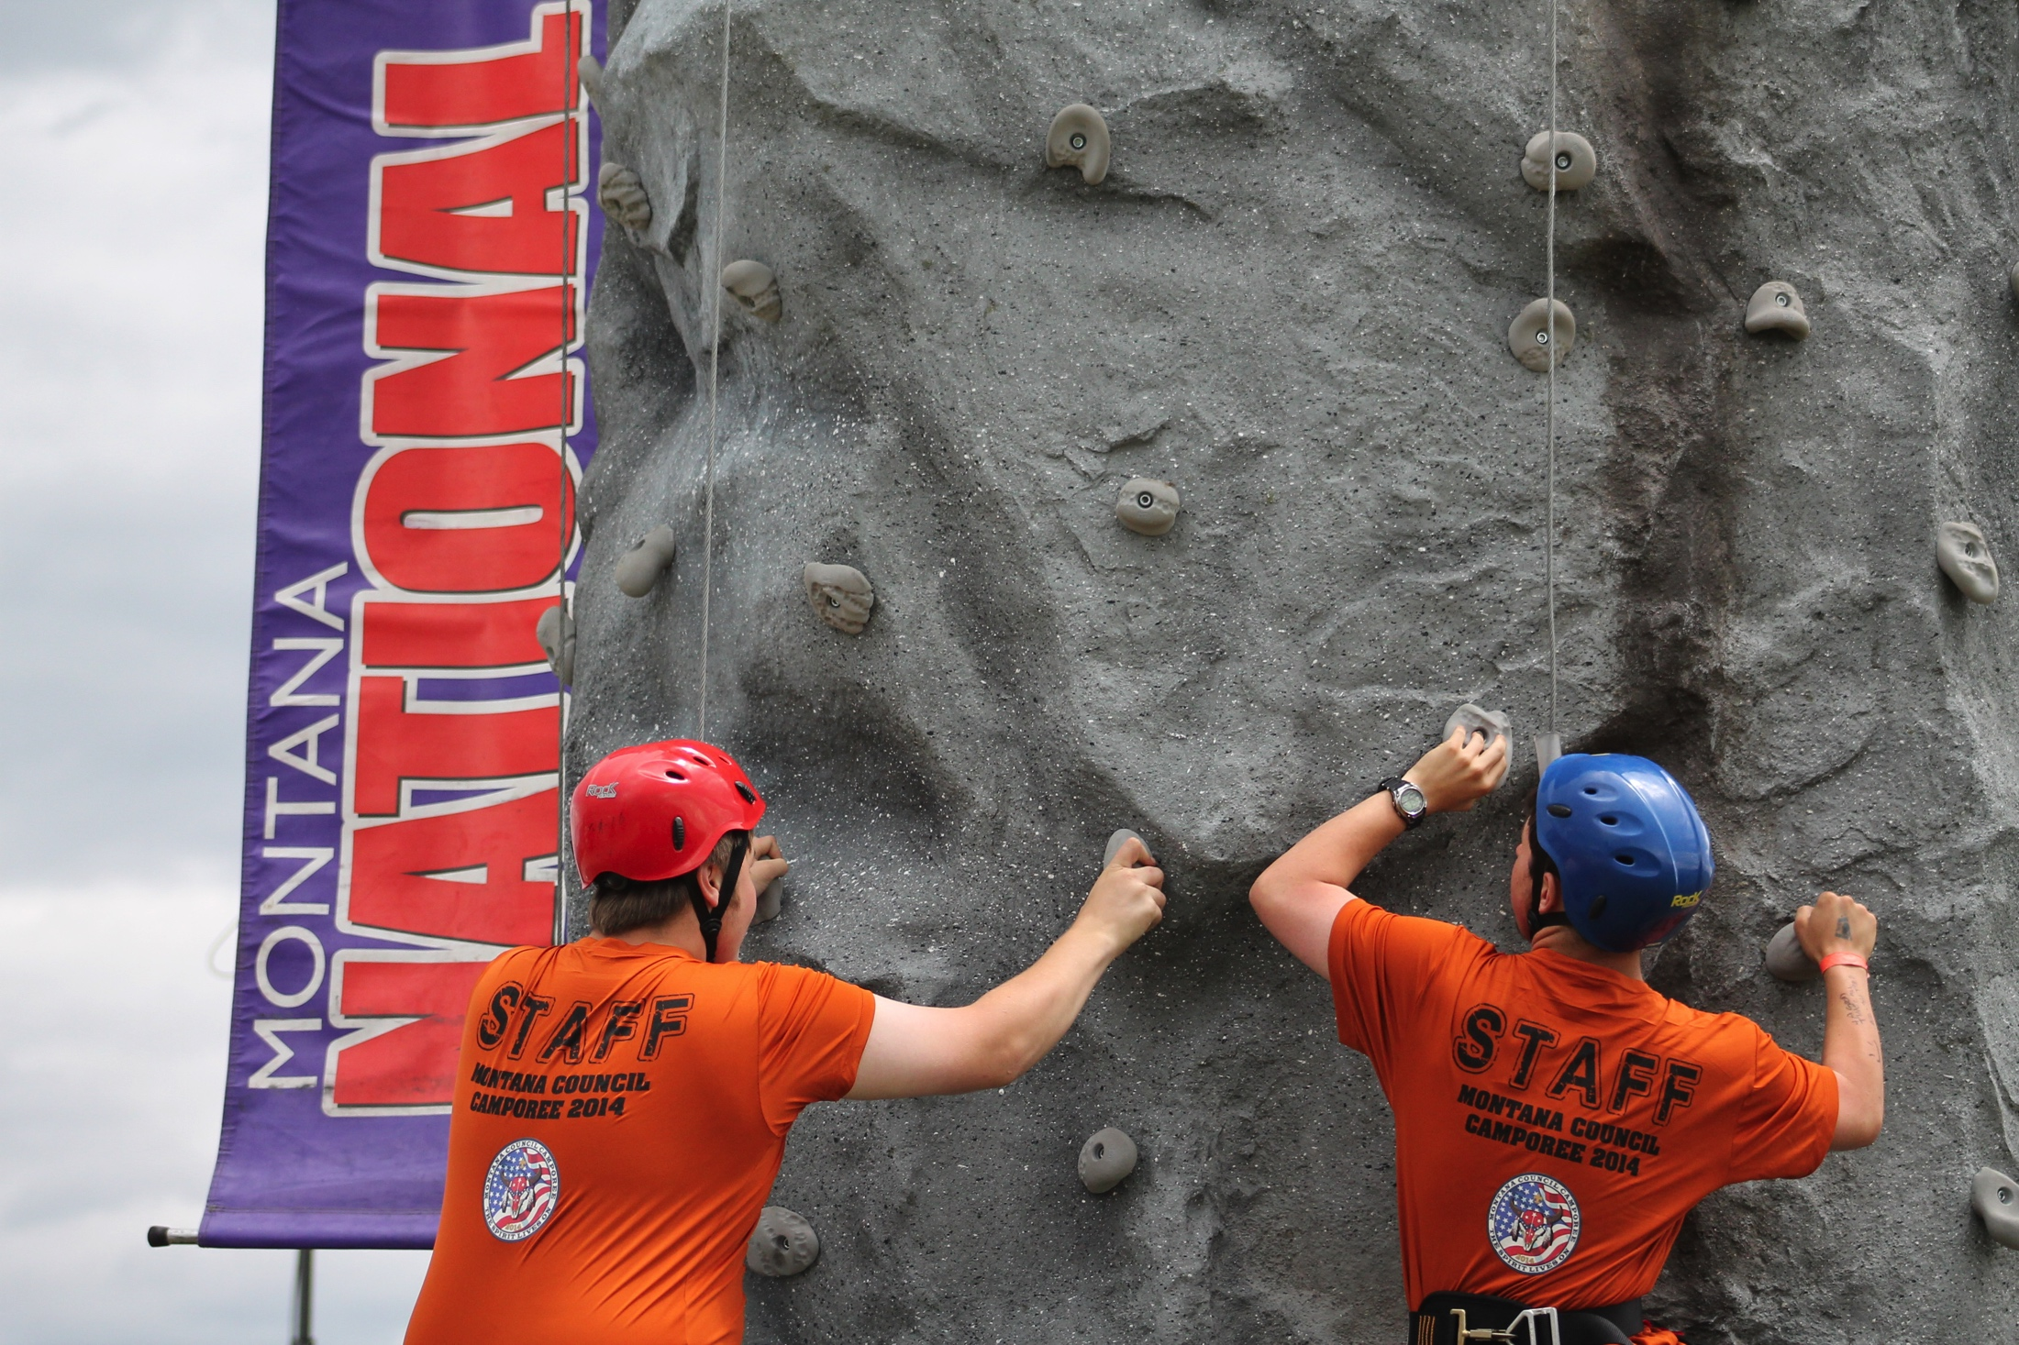
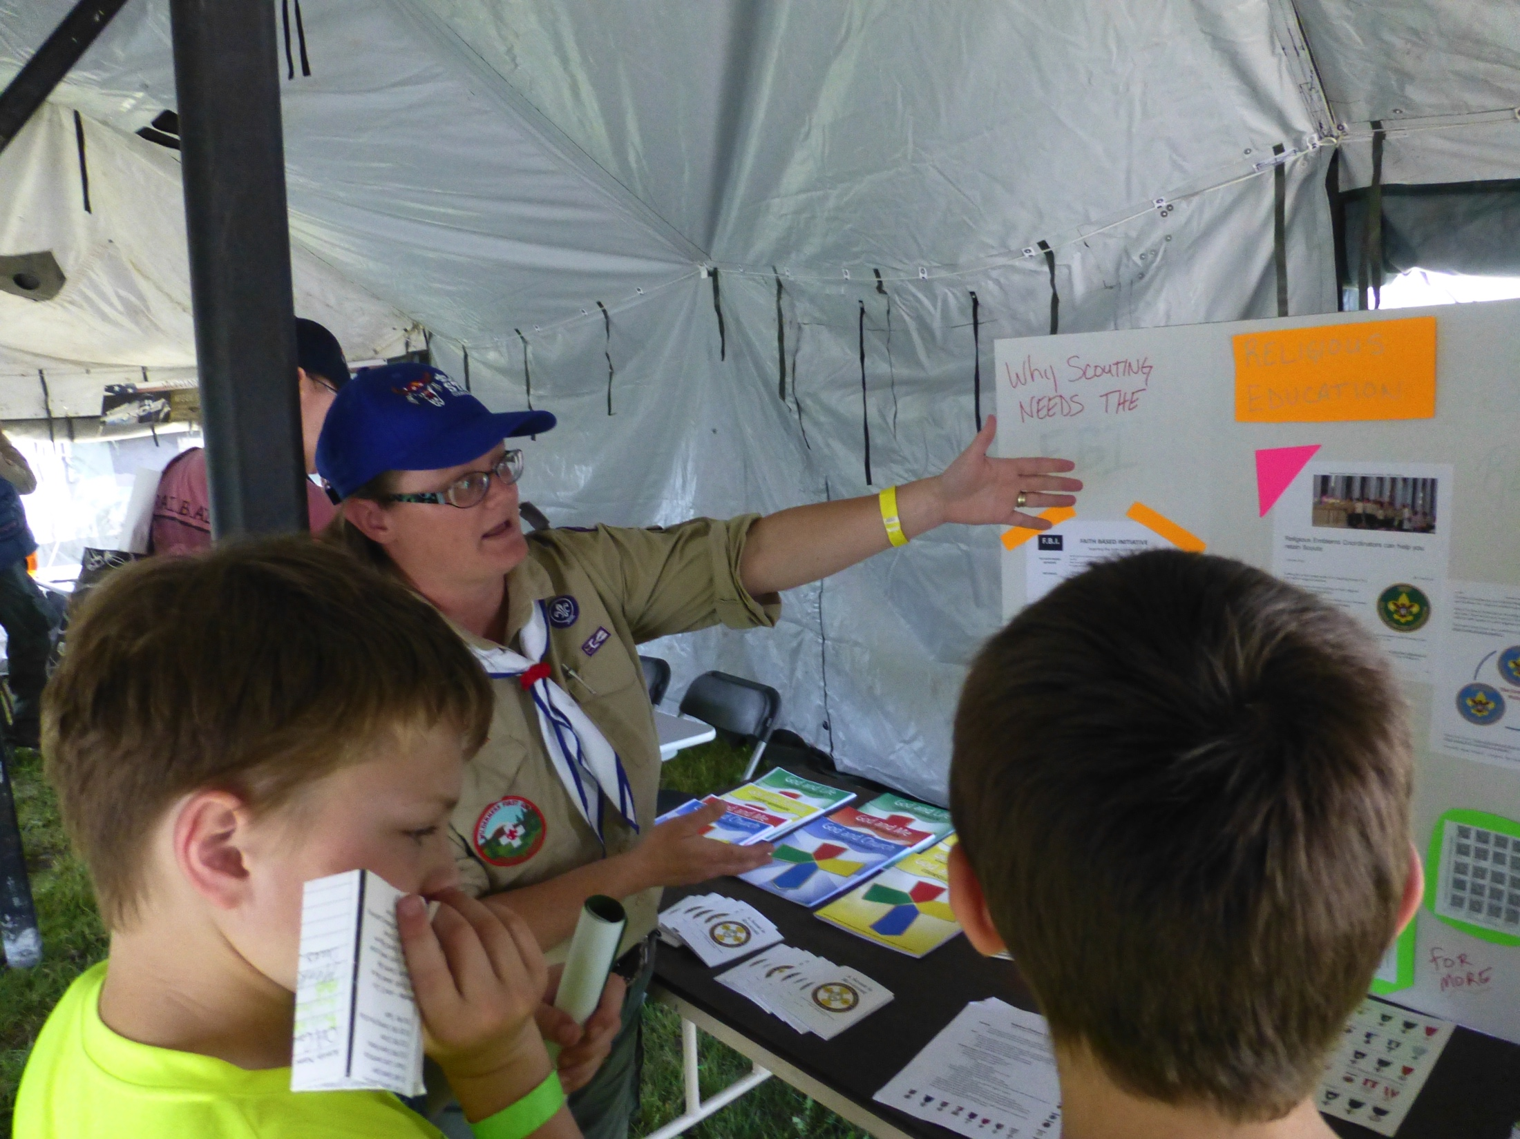

Slide 6
What Else is there to see?
Demonstration by local Fire Department
Live Band – Stumbling Free
Campfire Skits
Huge Fireworks Show

Slide 7
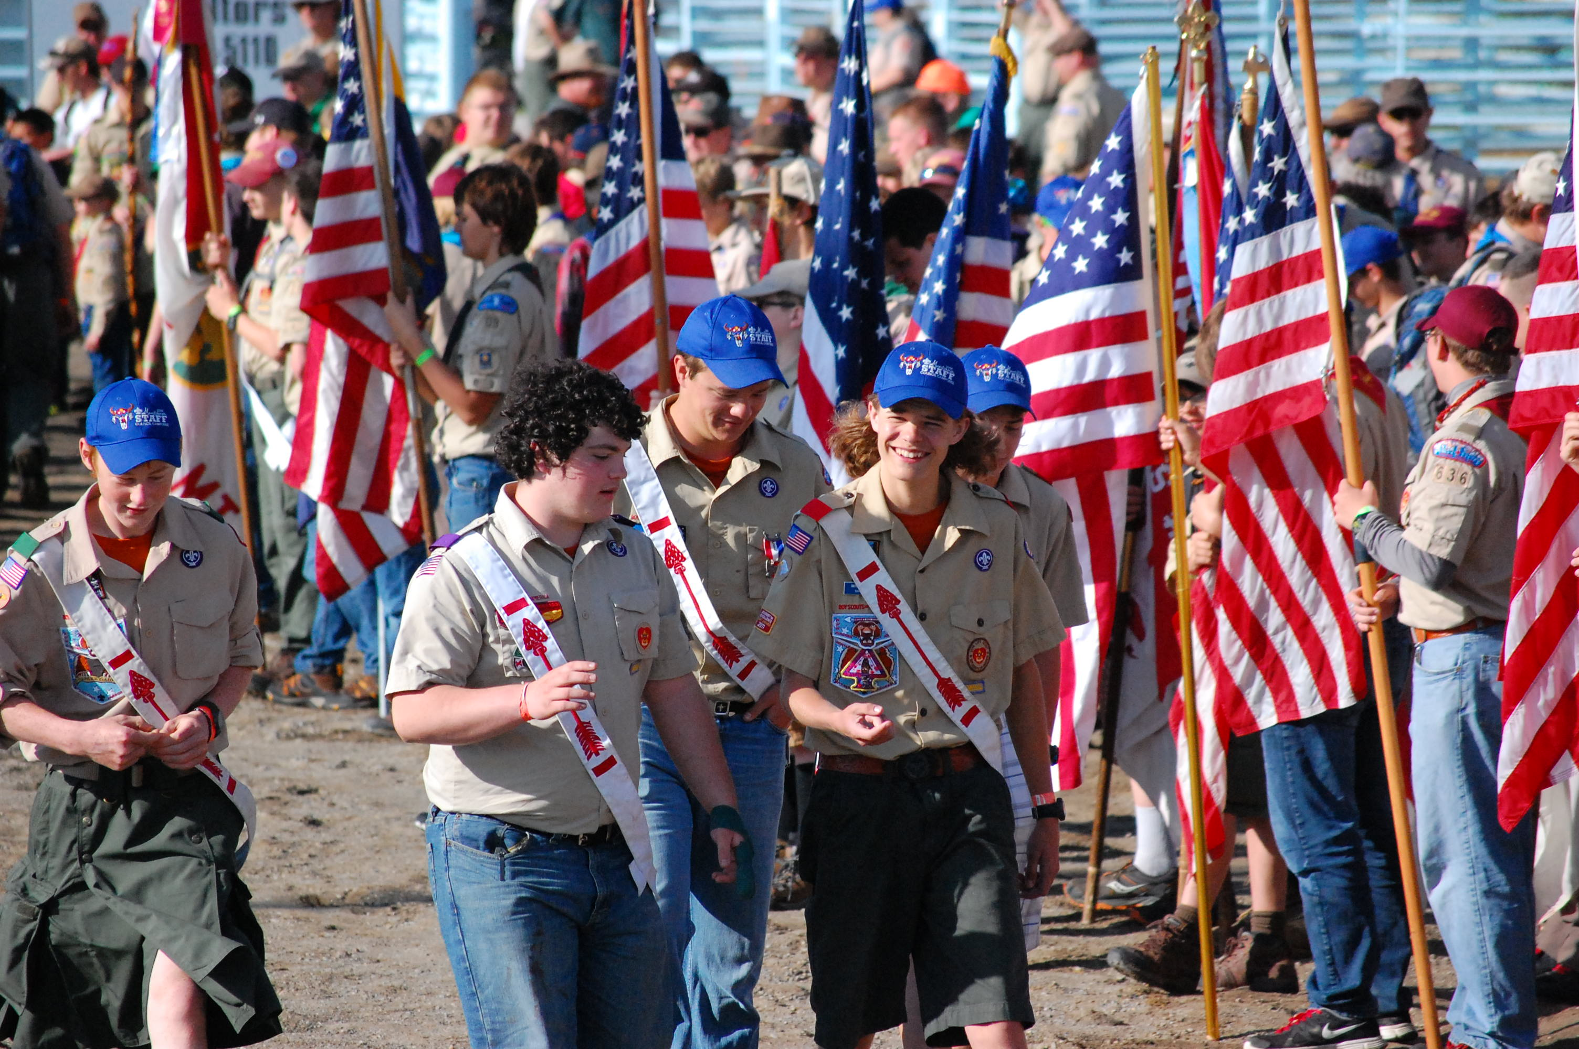
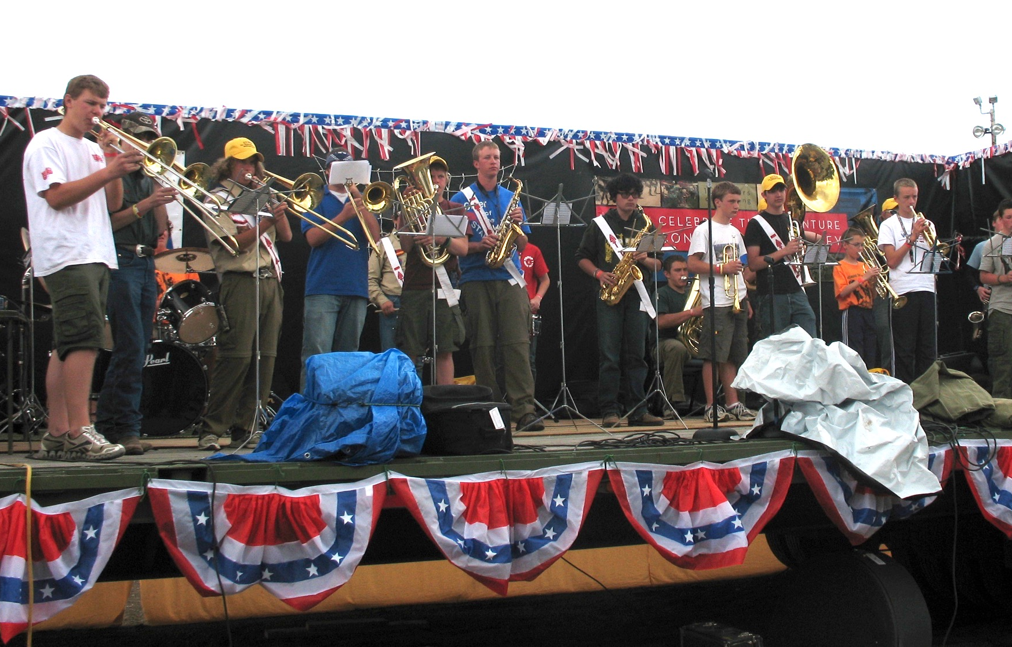

Slide 8
Where Do We Stay?
All participants will be assigned a Unit Campsite in Jamboree Style (close together with designated pathways between camps)
Units will setup tents and dining shelters within assigned Campsite
Units are responsible for cooking their own food of their choosing

Slide 9
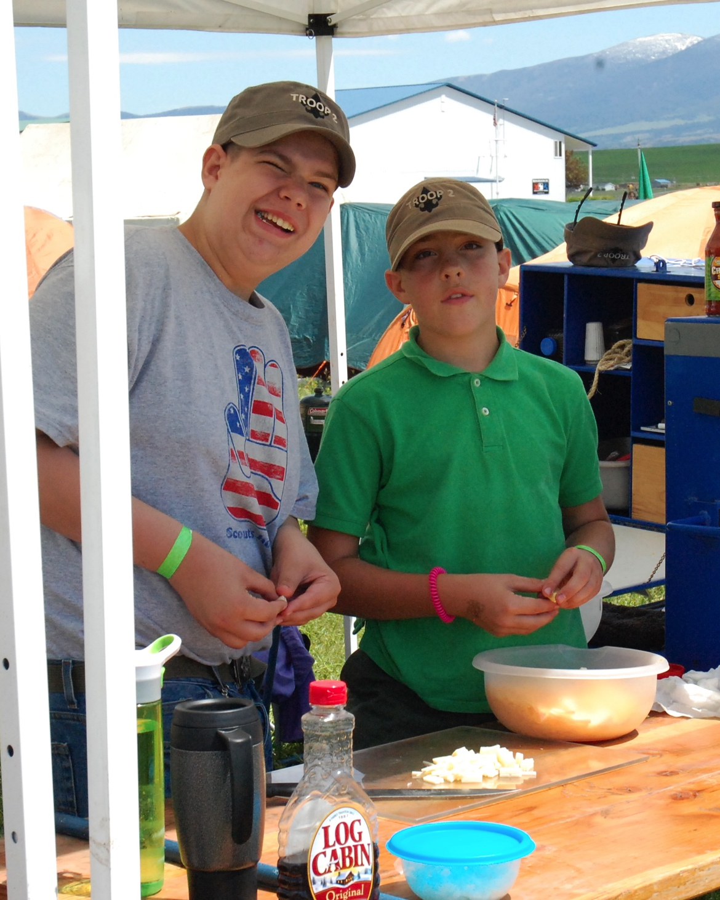
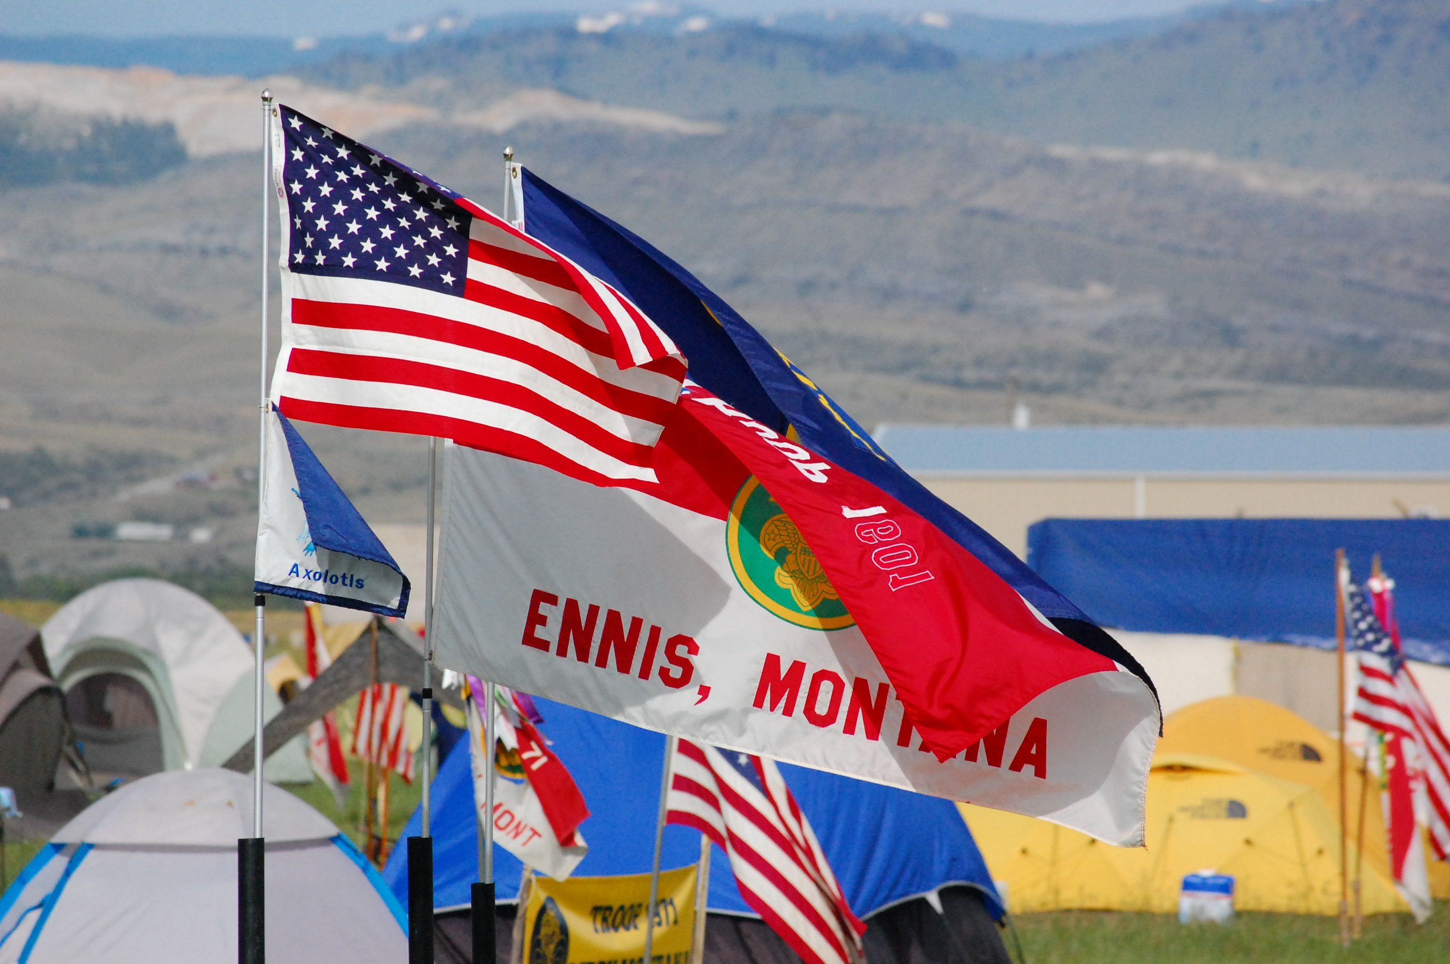
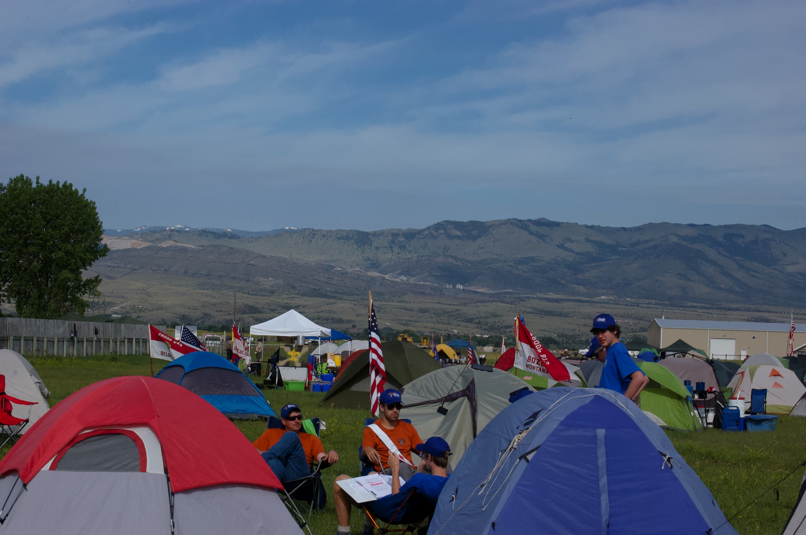
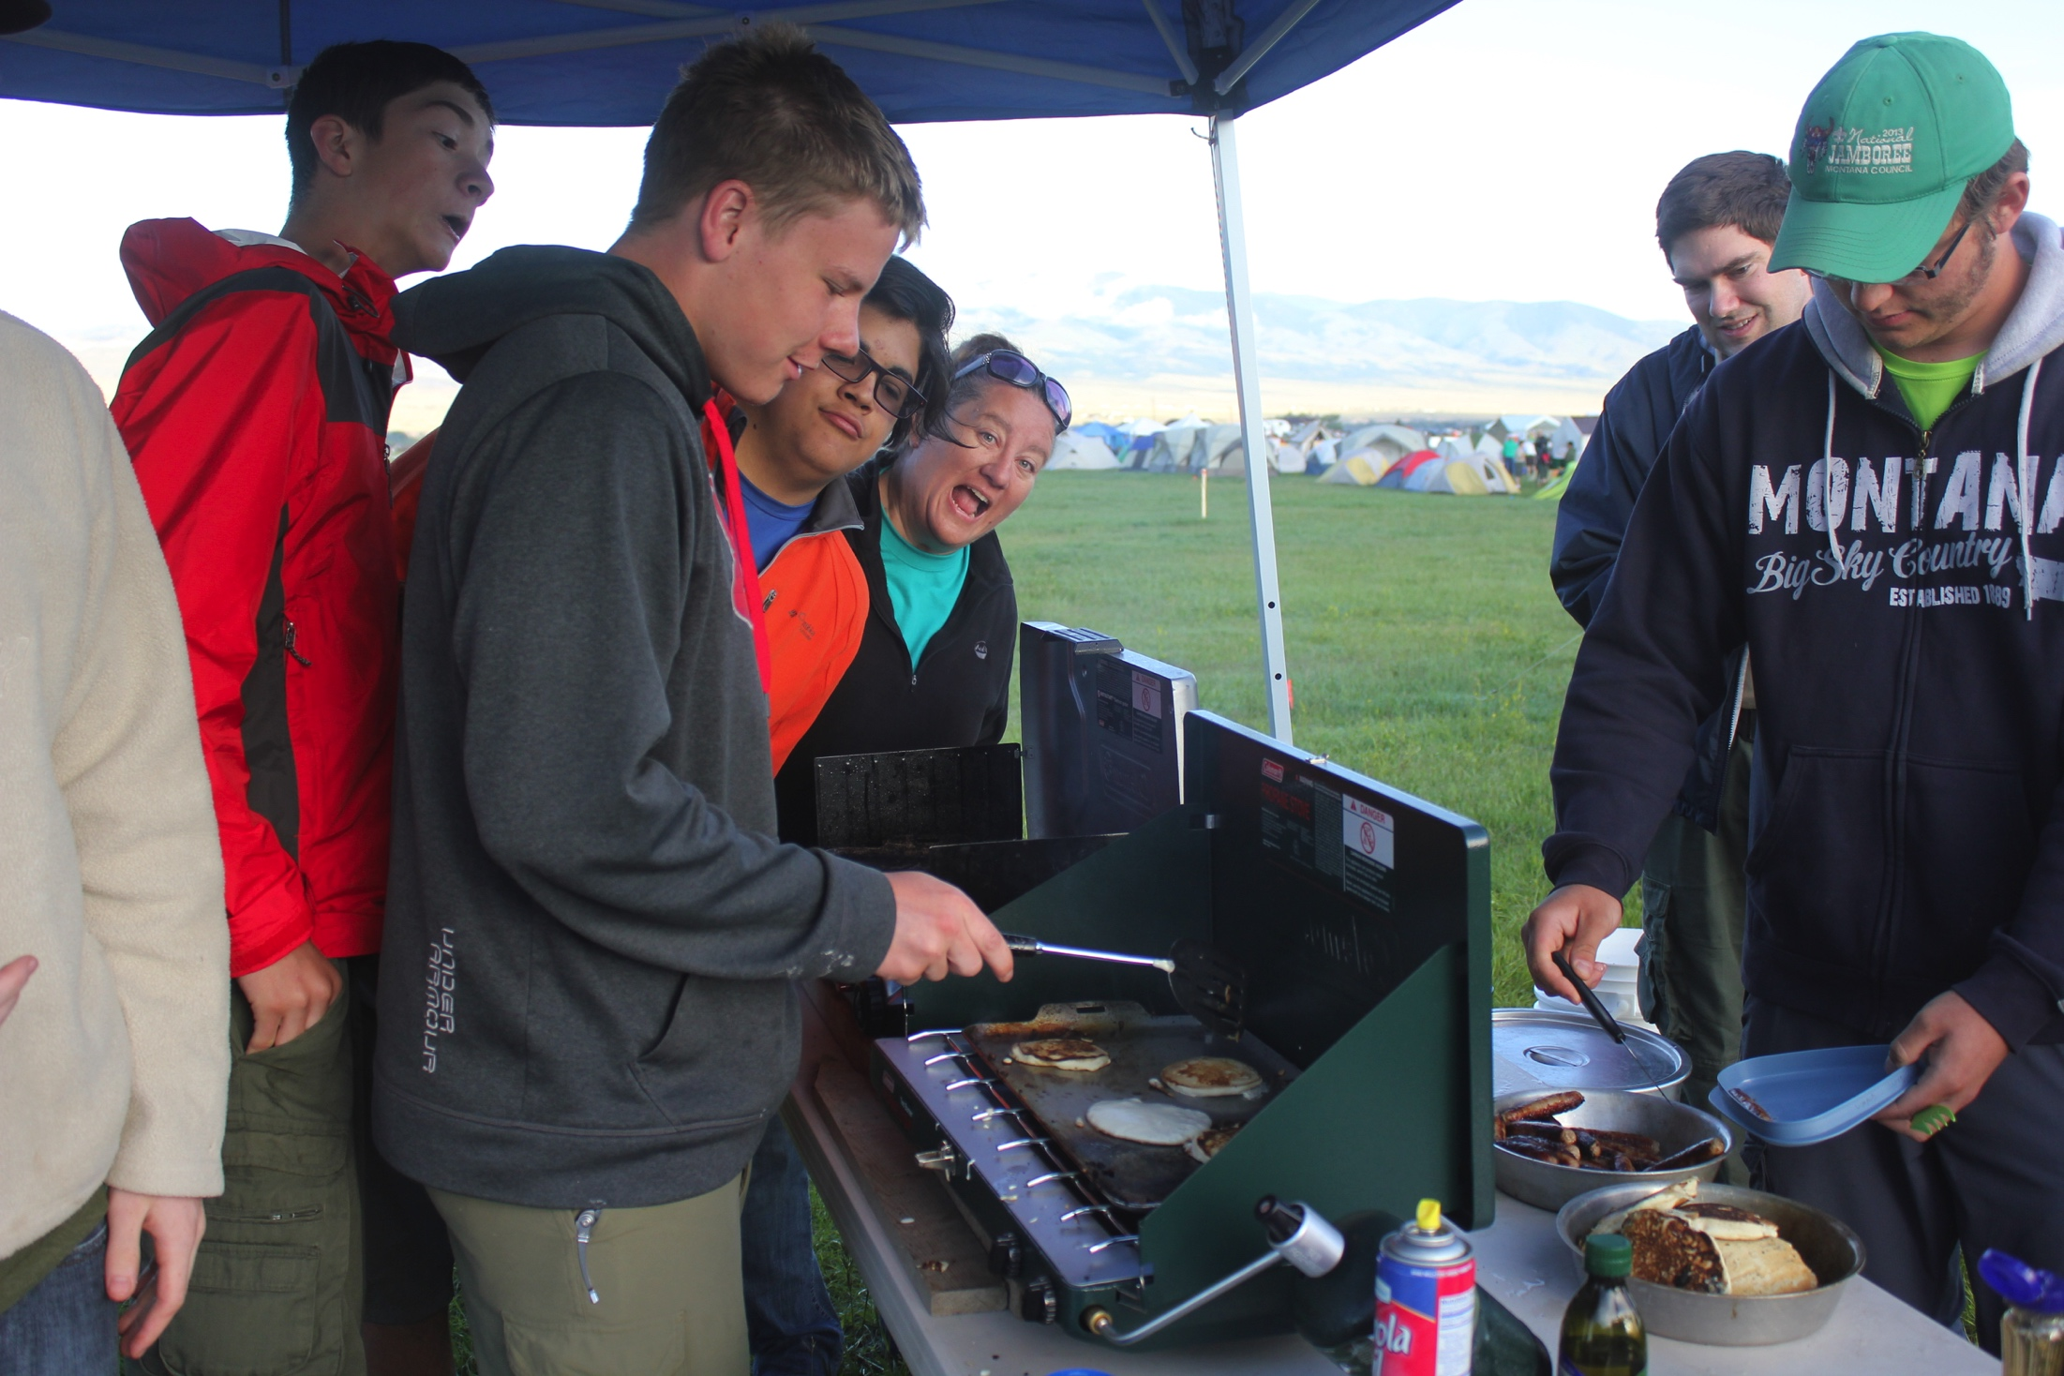

Slide 10
What is the Schedule Like?
Check-In begins on Thursday afternoon, with some activities beginning as units arrive
Friday begins with an opening address with activities running through out the day
Full Camp Show on Friday Night featuring the band Stumbling Free
Activities resume on Saturday, followed by a Campfire style show with skits and awards
Religious services offered on Sunday morning followed by tearing down camp and returning home

Slide 11
Can I be on Staff?
The Camporee planning committee is looking for people to fill the following staff positions:
OA Dirty Jobs Crew Staff (youth and adult)
Kitchen Staff
Medical Staff
Commissioners Staff
General Event Staff
Apply online at www.montanabsa.org/news-events/events/council-camporee/for-staff/

Slide 12
2018 Montana Council Camporee
June 14-17th, 2018
Townsend, MT

