Slide 1


Fun Cub Scout Meeting #3
6-Essentials Jeopardy Scavenger Hunt
Video Conference & PowerPoint
Introduction for Leaders
Notes:
If you need access to a remote service, every District has a Lifesize account. Just call your District Executive! He/She can give you the link and help you the first time.
If a parent has an account like ZOOM, get them to help you.

Slide 2
Introduction Cub Scout Meeting #3
Fun Cub Scout Meeting 1 and 2 had several different activities in the meeting. This meeting is different, since you have one activity for the entire meeting which is playing a game using a Jeopardy Board to collect the 6-essentials.
This is a competition, but all Cub Scouts will get the opportunity to play because the turns rotate (unlike Jeopardy where the player continues if they are the fastest in answering correctly).
Leaders have many opportunities to encourage Scouts to participate in discussions throughout the game.
This is a good meeting to use over the summer. You can encourage Cub Scouts to show you their 6-essentials at the end of the meeting.

Slide 3
Game Directions – For Leaders
Game Objective:
  Get the highest number of points by collecting the 6 essentials (flashlight, filled water bottle, whistle, first aid kit, sun protection, and trail food). Each essential is 1 point.
    You can collect 2 waters (2 points) but NOTE the extra weight in your pack!
    You can collect 2 trail foods (2 points).
    Unnecessary things count as negative points (video game, etc).
    Some things can be “neutral”, meaning you can collect it but it doesn’t count as a point unless there is a tie. (Deck of Cards)
Take turns having Scouts pick a Category and Rank.
  They can play in pairs too!
Each slide has an item on it. If the Scout answers the question – they get to keep the item (they should keep track on a list) – if it would be helpful an outing!
A few cards have “Trade” in the answer. This gives the Scouts an opportunity to trade if they have extra of something.
Final Jeopardy is “wild card” so Scouts can pick one thing to add to their collection.

Slide 4
Leader Game Facilitation Suggestions
Have a simple way to select who goes next. In a live game, it would be “player on the left goes next” or something equivalent. You can take turns alphabetically by first or last name or play in teams and simply pick a teams/dens order and stay with that.
Get them talking about the thing they find. Questions you can ask:
  Is this one of the 6 essentials?
  Why is this important?
  If this isn’t an essential, would you be allowed to bring it? If no, don’t bring it unless you want to lose a point.
Avoid too many directions! The game is self-explanatory once you do a round or two. When the “Trade” slide appears, explain that then.

Slide 5

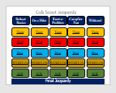
Leaders: How to “Work” the PowerPoint
Use “Slideshow Mode”
Each of the slides is linked. Scouts pick a Category (Bobcat Basics) and a Rank (Wolf).
Click on the link to go directly to the question slide.
NOTE: Keep track of which ones you have used! Sorry – this template does not dim after you have used it.

Slide 6
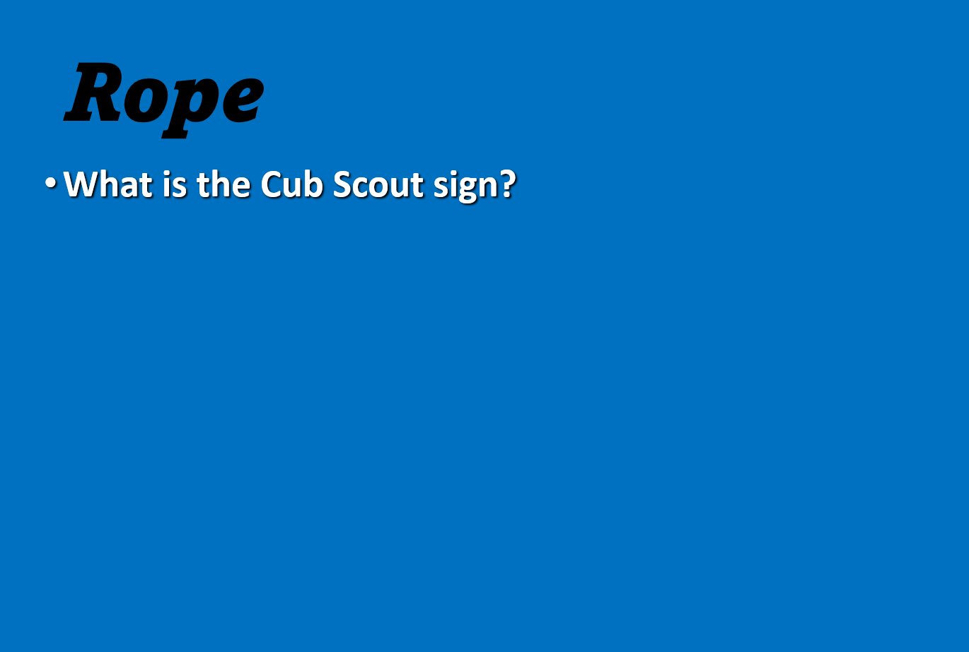
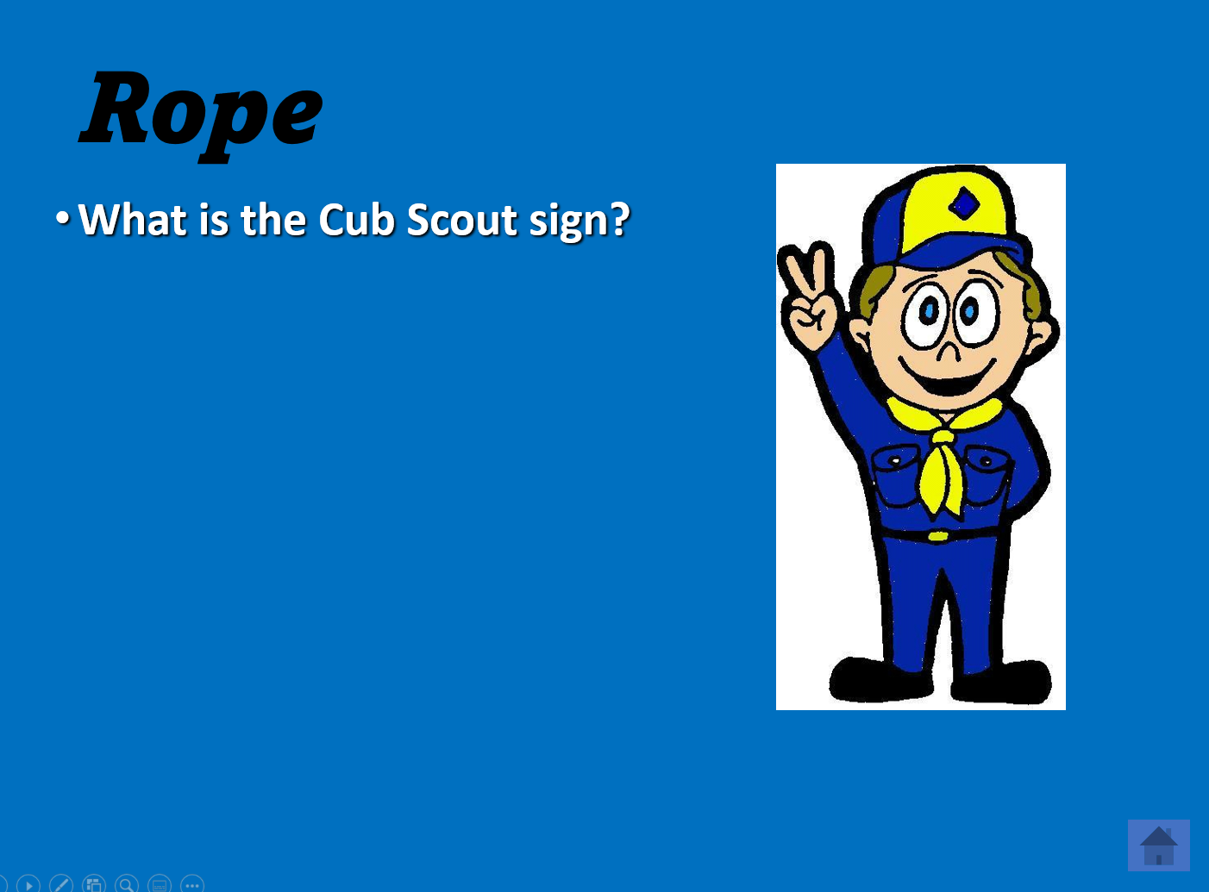
Leaders: How to “Work” the PowerPoint
The object they “found” is in BOLD TEXT at the top of the slide. If they get it right, they collect this item OR decide to leave it to avoid negative points.
Each question slide is “animated”. When you click the mouse, the answer will appear.
Click on the “house” icon to return to the main Jeopardy Board and the next Scout takes their turn.

Slide 7
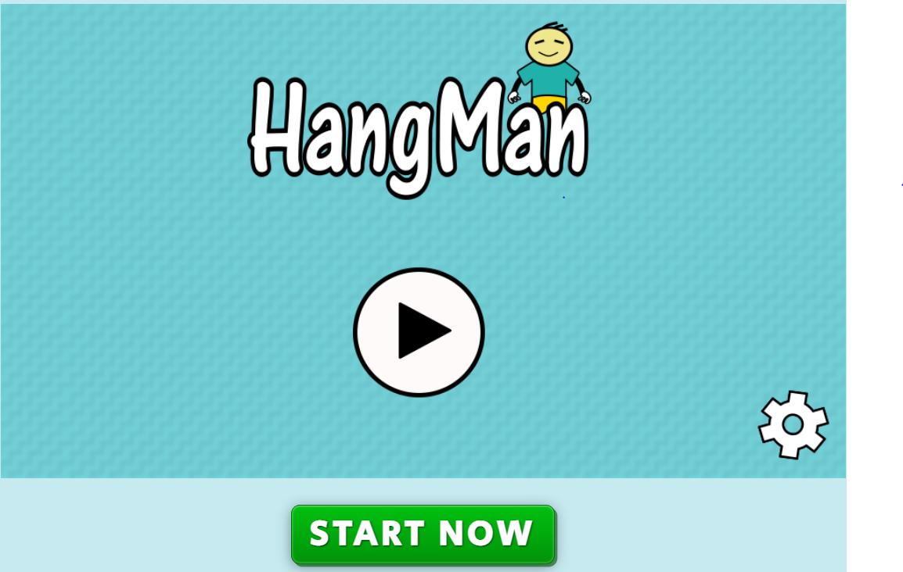
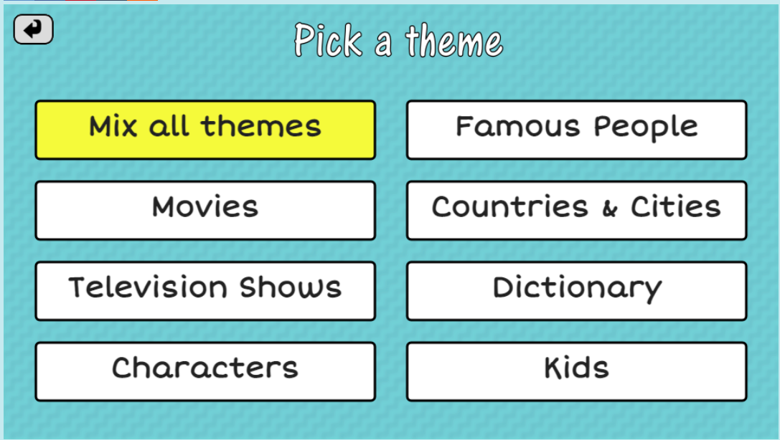
Plan B - Hangman
If the game goes too fast and you need something else to do, Hangman is a simple game that kids enjoy. There is a slide included AFTER the end slide in case you decide to use it.
Divide into teams or pairs.
Try the game first.
https://thewordsearch.com/hangman/

Slide 8
Fun Cub Scout Meeting #3
6-Essentials Jeopardy Scavenger Hunt
Video Conference & PowerPoint
Notes:
If you need access to a remote service, every District has a Lifesize account. Just call your District Executive! He/She can give you the link and help you the first time.
If a parent has an account like ZOOM, get them to help you.

Slide 9
6-Essentials Scavenger Hunt!
Get paper and pen/pencil. Write down what you collect.
Takes turns answering questions OR doing what the slide says.
Object – get the most points!
  Each essential +1 point.
  Extra Water – +1 point
  Extra Food – +1 point
  Unnecessary things – minus 1 point
How will we play?
  Teams?
  What is the play order?

Slide 10
Cub Scout Jeopardy
Bobcat
Basics
On a Hike
Knot-a-
Problem
Campfire
Fun
Wildcard
Tiger
Tiger
Tiger
Tiger
Tiger
Wolf
Wolf
Wolf
Wolf
Wolf
Bear
Bear
Bear
Bear
Bear
WEBELOS
WEBELOS
WEBELOS
WEBELOS
WEBELOS
AOL
AOL
AOL
AOL
AOL
Final Jeopardy

Slide 11
Flashlight
What is the Cub Scout Motto?
Do Your Best

Slide 12

Rope
What is the Cub Scout sign?

Slide 13
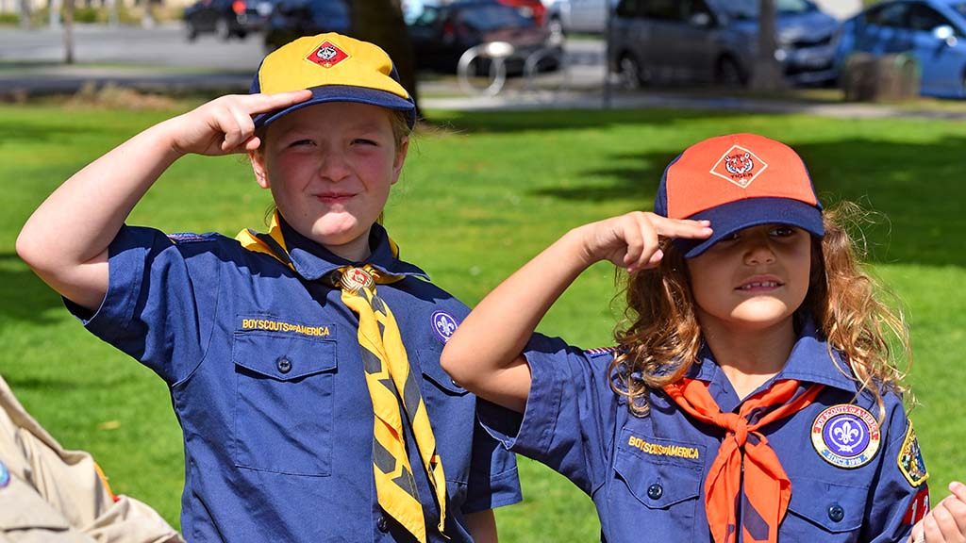
Large Trash Bag
What is the Cub Scout salute?

Slide 14
Trail Food
Name the Cub Scout RANKS.
Lion, Bobcat, Tiger, Wolf, Bear, WEBELOS, Arrow of Light

Slide 15
Matches
What does WEBELOS stand for?
We – Be – Loyal - Scouts

Slide 16
Flashlight
When can you join Scouts BSA and be in a TROOP?
5th grade in the SPRING when you cross over from Cub Scouts.

Slide 17
Deck of Cards
What is the Buddy System and when do you use it?
The Buddy System is a pair of Cub Scouts who stay together whenever we hike, camp, swim, or go on outings.

Slide 18
Water Bottle
True or False – You can leave an apple core along a trail because the animals will eat it.
FALSE – Scouts always try and “leave no trace” outdoors or indoors.

Slide 19
Trail Food
True or False – You can drink stream water if it is higher in the hills and is swiftly moving water.
FALSE – You only drink water you bring, or you learn how to treat stream water to make it safe to drink.

Slide 20
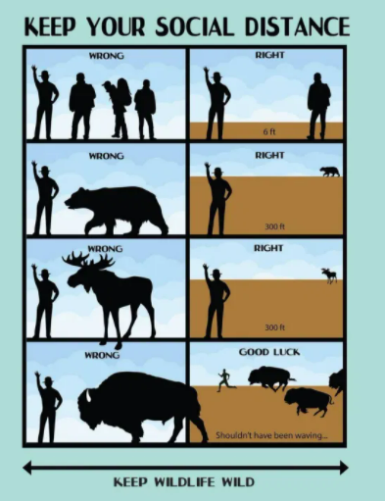
Sun Protection
True or False - You can get as close as you want to a wild animal as long as you don’t get bitten.
FALSE – you want to keep a distance from wild animals and not disturb them. The distance depends on the animal.

Slide 21
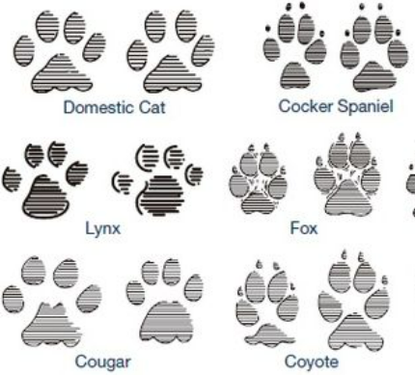
Sun Protection
How can you tell Bobcat tracks (cat tracks) from Coyote tracks (dog tracks)?
Cat tracks you will not see the claw since they retract. Dog tracks you will see the claw.

Slide 22

Video Game
What is the first knot every Cub Scout learns?
The Overhand Knot

Slide 23

Flashlight
Name this knot.
Square Knot – also called the Joining Knot because it is good for joining two pieces of rope together.

Slide 24

Personal First Aid Kit
What is this knot?
This is a HALF HITCH.
TRADE OPTION!

Slide 25

Whistle
What is this knot?
Two Half Hitches

Slide 26
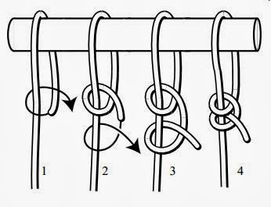
Pocket Knife
What knot would be good to use to tie a rope to a tree or any other object?
Two Half Hitches

Slide 27
Wallet
Name two things you could do to at a Cub Scout Campfire?
Tell a joke, lead a cheer, sing a song, tell a story, do a skit, roast marshmallows, or other entertainment!

Slide 28
Pet Snake
True or False – You can tell any joke you want at a Cub Scout Campfire if it makes some people laugh.
FALSE – Always follow the Oath and Law. Jokes should still be kind, friendly, and helpful. Never make fun in a mean way of another scout, person, group, or situation.

Slide 29
Can of Soda
Name 2 things you need to have near your campfire before you build your fire to PREVENT fire accidents. This is fire safety equipment.
Water or sand to put out the fire and a shovel.
TRADE OPTION!

Slide 30
Personal First Aid Kit
Lead a “repeat after me song” or tell a joke!
Just for fun - What are your favorite campfire songs?

Slide 31
Whistle
True or False – as soon as you can’t see any flames, it is safe to leave.
FALSE – The fire is not “out” until the ashes are cold to the touch.

Slide 32
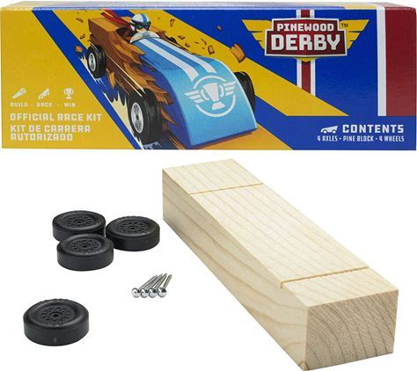
Whistle
What is a Pinewood Derby?
A Pinewood Derby is a race of cars build from a kit but decorated and customized by Scouts.
Do you have any tips for winning your Pinewood Derby?

Slide 33
Snickers Candy Bar
All Cub Scouts are allowed to use a pocketknife as long as leaders are there.
FALSE – You have to be at least BEAR rank and take the safety class to earn your knife Totin’ Chip.

Slide 34
Trail Food
True or False – On a hike, you can run ahead of the leader and other Scouts as long as you have a Buddy with you.
FALSE – you need to remain near your hiking group even if you have a buddy.

Slide 35
Personal First Aid Kit
Name one safety rule when you are at a Scout Archery Range.
Follow the range commands, Don’t enter the Range without permission, only point your arrow at the target, Don’t go downrange until the all-clear command is given.
TRADE OPTION!

Slide 36
Sun Protection
What does the “caller” do in a flag ceremony?
The caller gives the commands (directions) to the audience and the color guards for posting or retrieving the flag. Example:
  “Color Guard Attention”
  “Audience Attention”
  “Color Guard Advance”

Slide 37
Wild Card Item
(Pick Your Essential)
What is the motto of Scouts BSA and what does it mean? Write it on a piece of paper.
The motto is “Do a Good Turn Daily” which means every day you do something extra to help someone out and you don’t expect any reward for it.

Slide 38
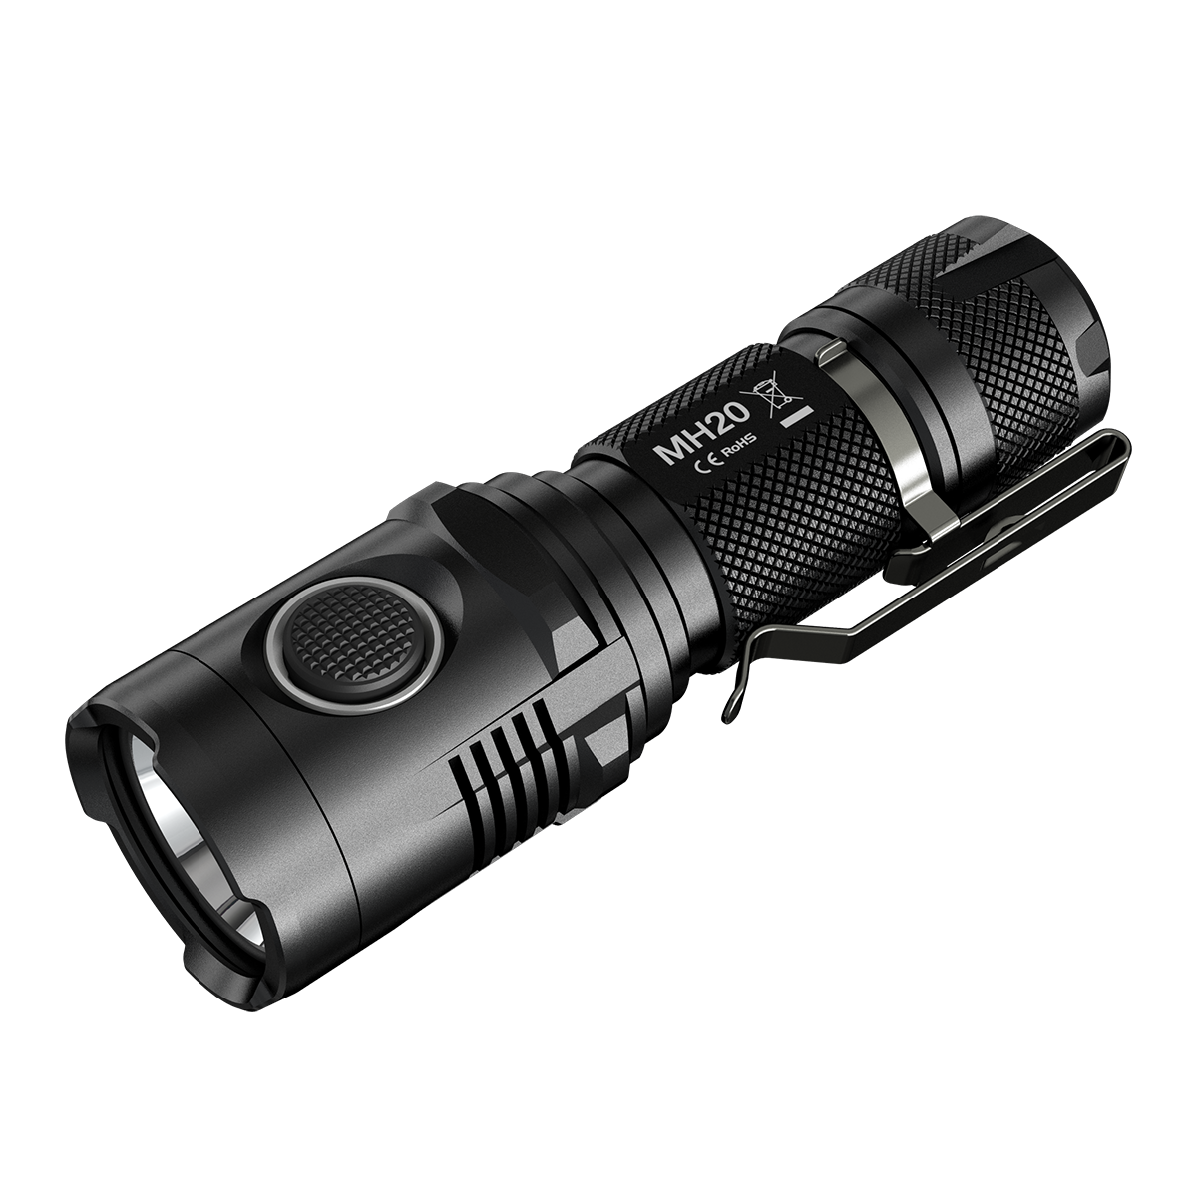
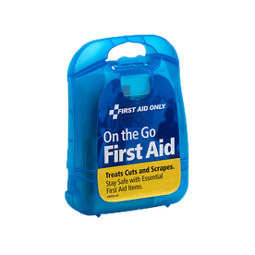
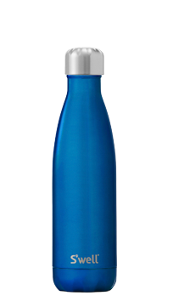
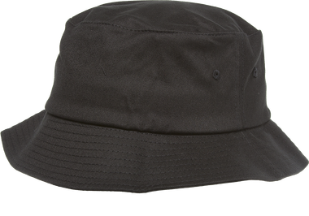


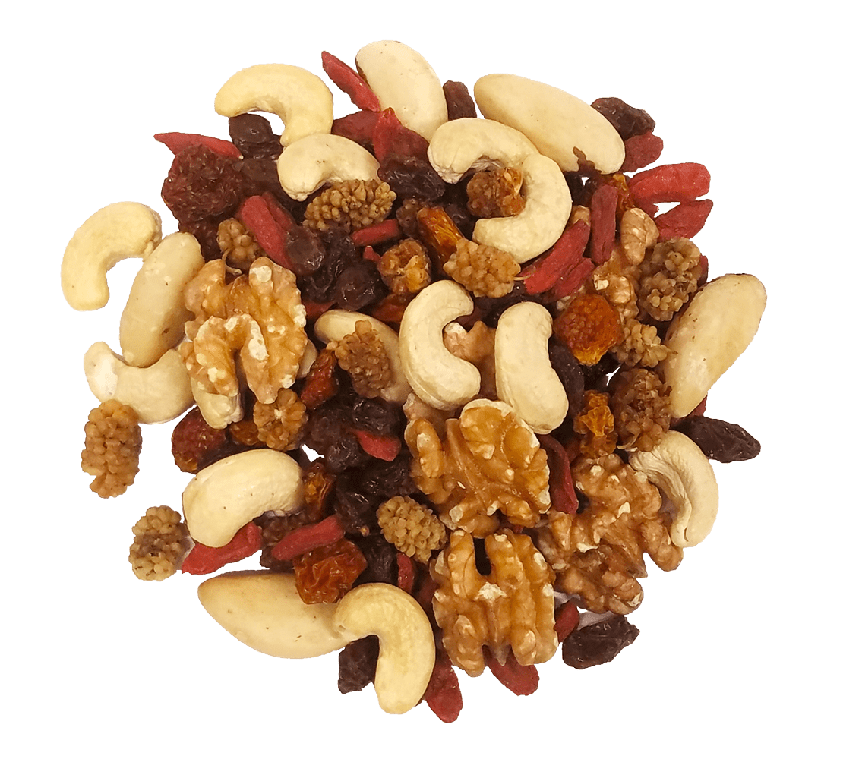
Game Scoring
One Point for Each Essential
  Water Bottle
  Flashlight
  Whistle
  First Aid Kit
  Sun Protection
  Trail Food
One Point Extra Water
One Point Extra Food
NEGATIVE Points for Unnecessary Things

Slide 39

Fun Cub Scout Meeting #3
Leader Minute
What is coming next?
Notes:
Wrap-up the meeting with a Leader Reflection and get feedback. Did they like it? What would they like to do?
Get ideas!

Slide 40
Fun Cub Scout Meeting #3
Get Together and Have Fun!
Betsy Eubanks
(Eubanks.betsy@gmail.com
Notes:
If you need access to a remote service, every District has a Lifesize account. Just call your District Executive! He/She can give you the link and help you the first time.
If a parent has an account like ZOOM, get them to help you.

Slide 41
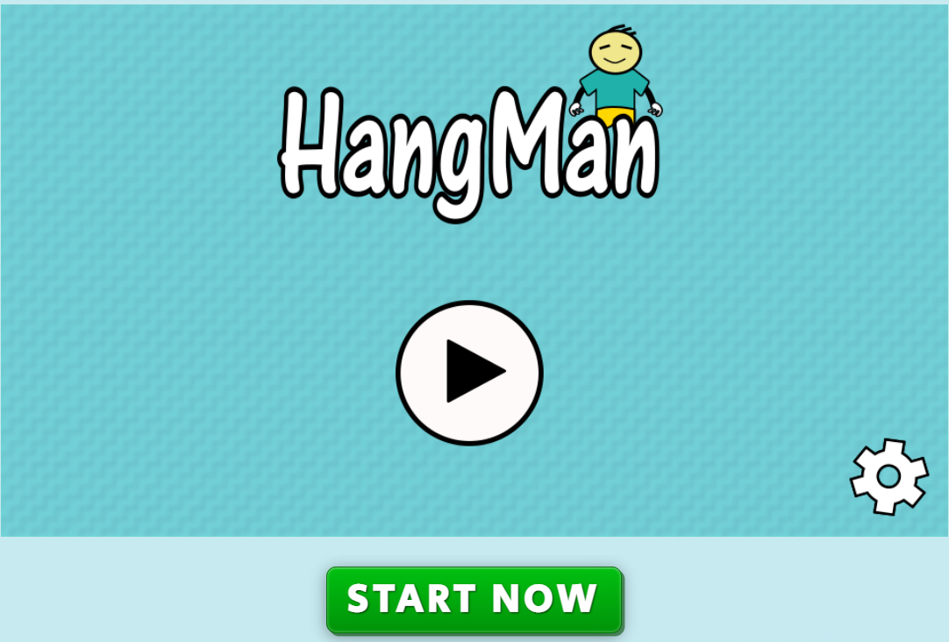
Notes:
https://thewordsearch.com/hangman/

